Slide 1
Options Buying
- Stock Gainers

Slide 2
A contract (agreement)
Giving a right to buy/ sell A specific asset
At a specific price
Within a specific time period

Slide 3
An Options contract confers the right but not the obligation to buy or sell a specified underlying instrument or asset at a specified price – the Strike or Exercise price, until or at specified future date – the Expiry date.
The option buyer has the right and option seller has the obligation i.e., option buyer may or may not exercise the option given, but, If option buyer decides to exercise the option, option seller has no choice but to honor the obligation.

Slide 4
Buyer of an option: The buyer of an option is the one who by paying the option premium buys the right but not the obligation to exercise his option on the seller/writer.
Writer / seller of an option: The writer / seller of a call/put option is the one who receives the option premium and is thereby obliged to sell/buy the asset if the buyer exercises on him.
Call option: A call option gives the holder the right but not the obligation to buy an asset by a certain date for a certain price.
Put option: A put option gives the holder the right but not the
obligation to sell an asset by a certain date for a certain price.

Slide 5
Option price/premium: Option price is the price which the option buyer pays to the option seller. It is also referred to as the option premium.
Expiration date: The date specified in the options contract is known as the expiration date, the exercise date, the strike date or the maturity.
Strike price: The price specified in the options contract is known as the strike price or the exercise price.

Slide 6
 | CE | PE
In the money | Spot Price > Strike Price | Spot Price < Strike Price
At the money | Spot price = strike price | Spot Price = Strike Price
Out of the money | Spot Price < Strike Price | Spot Price > Strike Price

Slide 7
Call
Out the Money | 1650
 | 1700
At the Money | 1600
In the Money | 1550
 | 1400
Put
Out the Money | 1500
 | 1400
At the Money | 1600
In the Money | 1700
 | 1800

Slide 8
 | CALL | PUT
Buy | Bull | Bear
Sell | Not so bullish | Not so bearish

Slide 9
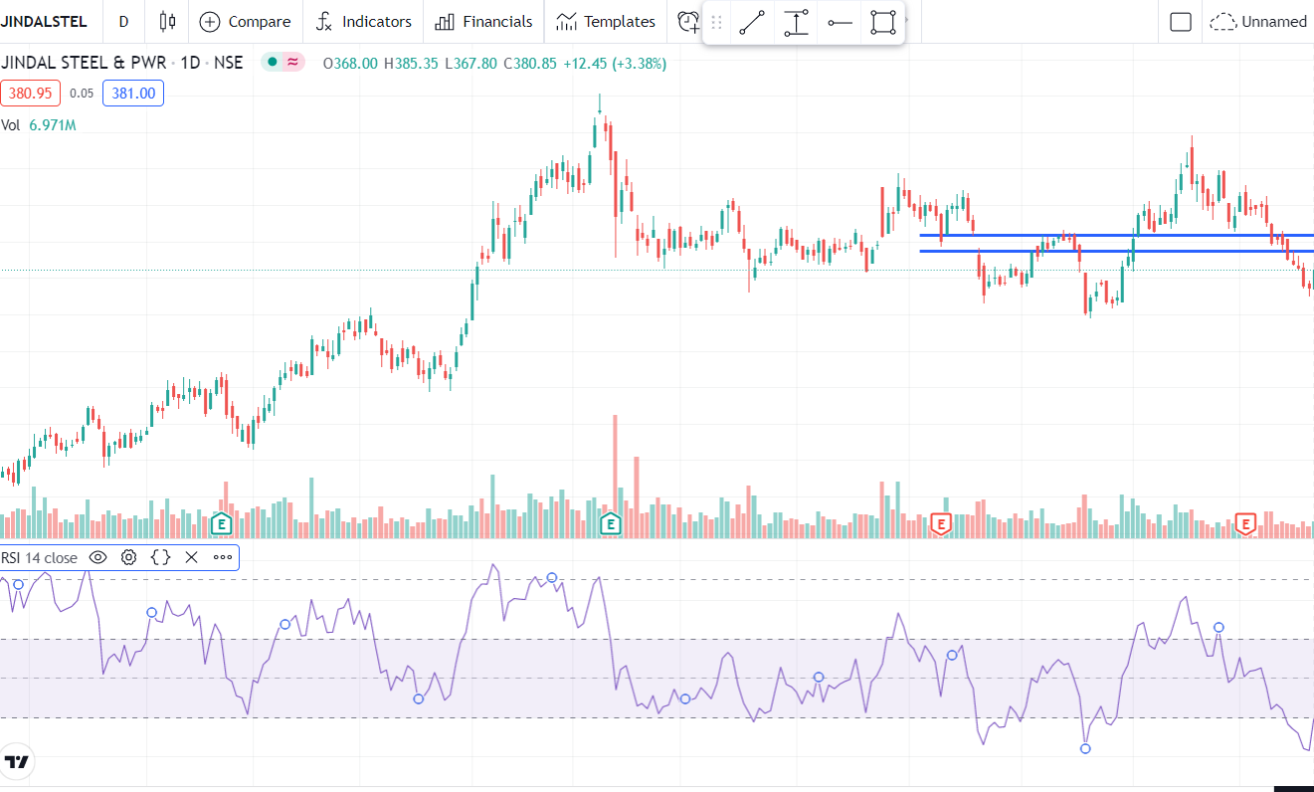

Slide 10
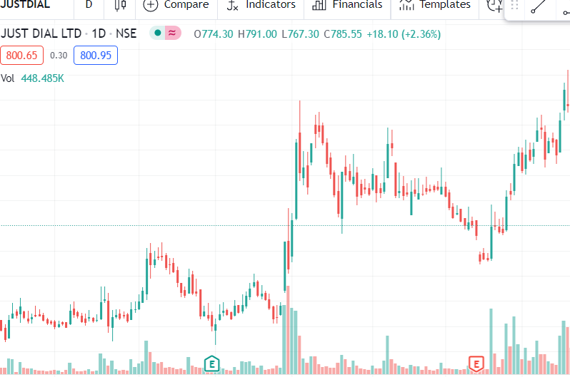

Slide 11
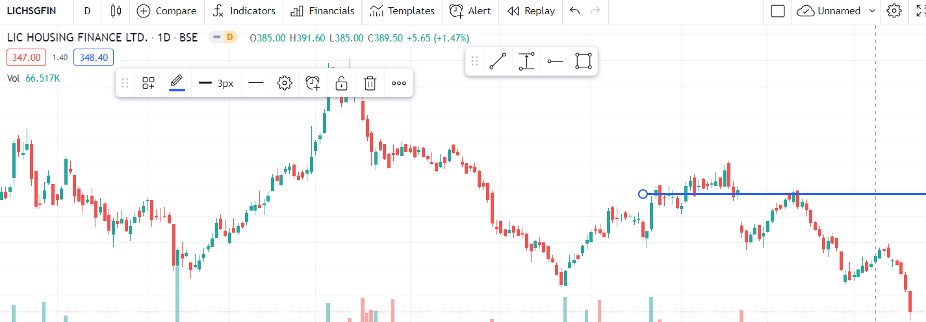

Slide 12
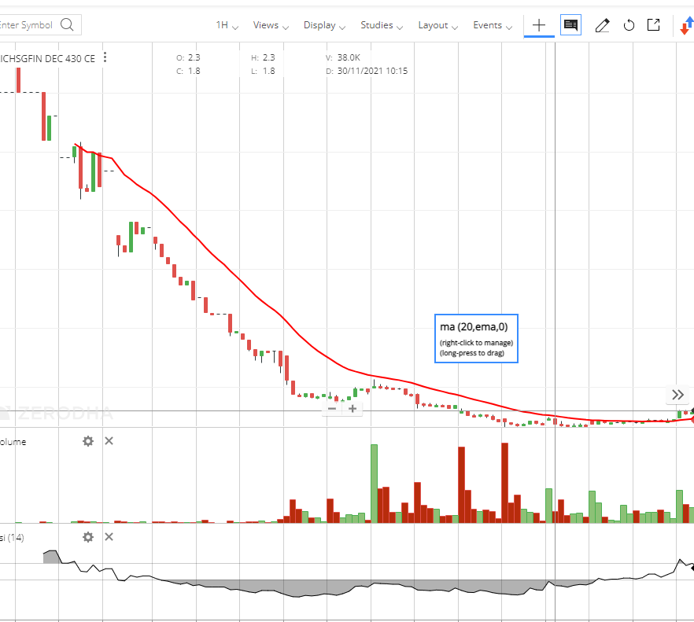

Slide 14
Moneyness Of Options
Option Premium is made of 2 things Intrinsic And Time value.
Call=Intrinsic + Time value
Intrinsic Value=Spot price - Strike price + Time to the expiry
Remember: Intrinsic value can never be zero or negative.

Slide 15
Put==Intrinsic value + Time value
Intrinsic Value=Strike price-Spot

Slide 16
PROTECTIVE CALL
Sell FUT & BUY ATM Call
Risk - limited
Reward - Unlimited
Shortening a Future Stock/ Index and Simultaneously Buy a call to protect from any Unexpected Rise.
Used by Mutual Fund Managers/ Hedge Funds/FIIs.

Slide 17
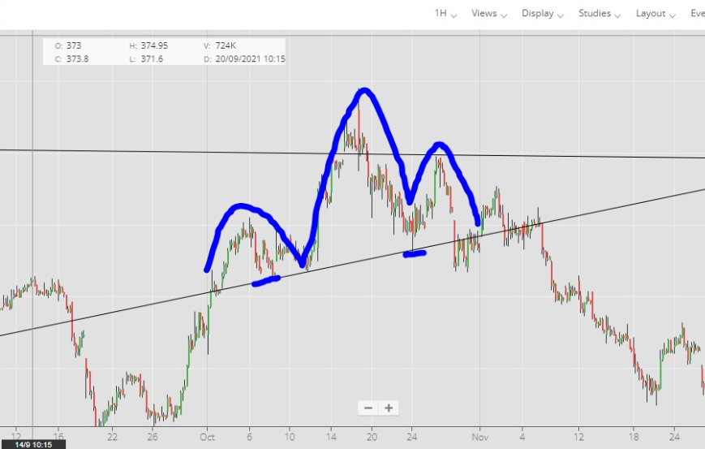

Slide 18
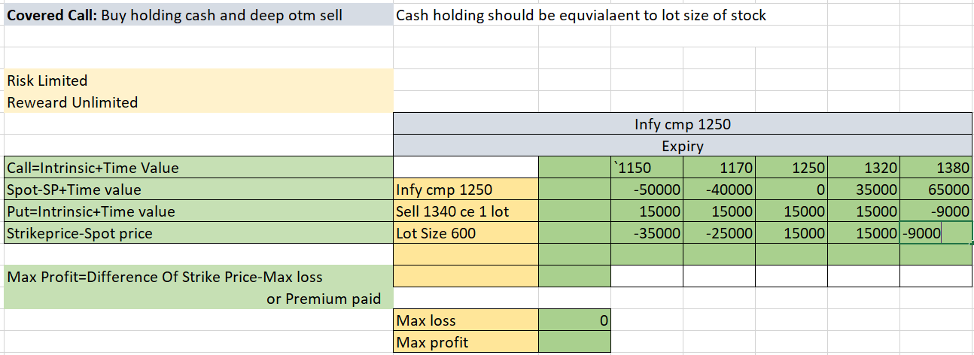
COVERED CAll
BUY CASH AND SELL DEEP OTM
THIS STRATEGY IS ONLY FOR INVESTORS.

Slide 19
COLLAR STRATEGY
BULLISH STRATEGY And Risk is fixed
BUU FUT 1 LOT
BUY PE ATM 1 LOT
SELL 5TH STRIKE PRICE CE

Slide 20
Long Strangle
BUY OTM Call & OTM Put.
Risk - limited
Reward - Unlimited
Expect Huge Volatility in the markets on either side of Direction.
Trended Move..
Used by Mutual Fund Managers/ Hedge Funds/FIIs.

Slide 22
Long Straddle
BUY ATM Call & ATM Put.
Risk - limited
Reward - Unlimited
Expect Huge Volatility in the markets on either side of Direction.
Trended Move..
Used by Mutual Fund Managers/ Hedge Funds/FIIs.

Slide 23
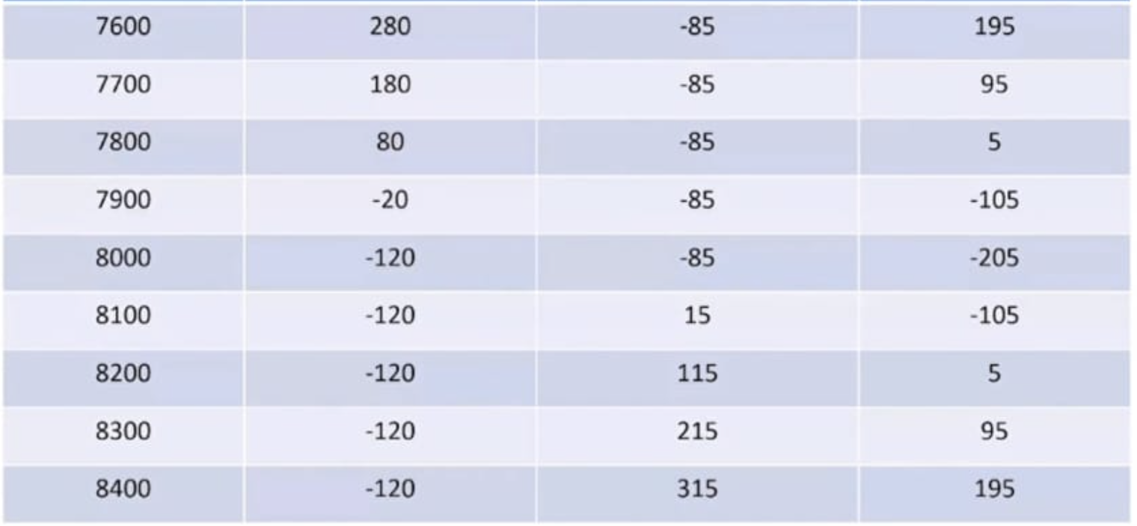
Long Straddle Payoff
Nifty @ Expiry | Put Payoff | Call Payoff | Net Payoff

Slide 24
Short Strangle
SELL OTM Call & OTM Put.
Risk - Unlimited
Reward - limited
Expects Range Bound move or lesser volatility in the Index or Stock
Used by Mutual Fund Managers/ Hedge Funds/FIIs.

Slide 25
Short Straddle
SELL ATM Call & ATM Put.
Risk - Unlimited
Reward - limited
Expects Range Bound move or lesser volatility in the Index or Stock
Used by Mutual Fund Managers/ Hedge Funds/FIIs.

Slide 26
BUY Call Spread
BUY ATM Call & SELL OTM Call.
Risk - limited
Reward - limited
Bullish on Stock/ Index
Used by Mutual Fund Managers/ Hedge Funds/FIIs.

Slide 27
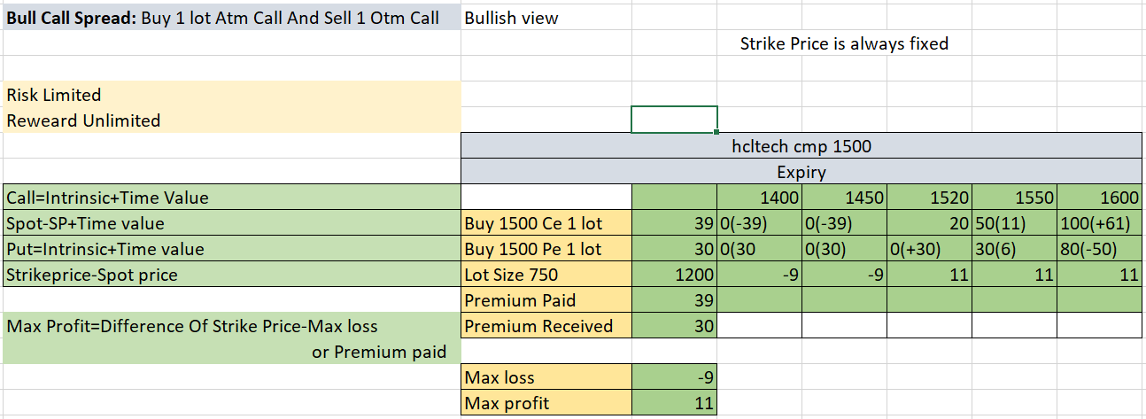

Slide 28
Bear Put Spread
BUY ATM Put & SELL OTM Put.
Risk - limited
Reward - limited
Bearish on Stock/ Index
Used by Mutual Fund Managers/ Hedge Funds/FIIs.

Slide 29
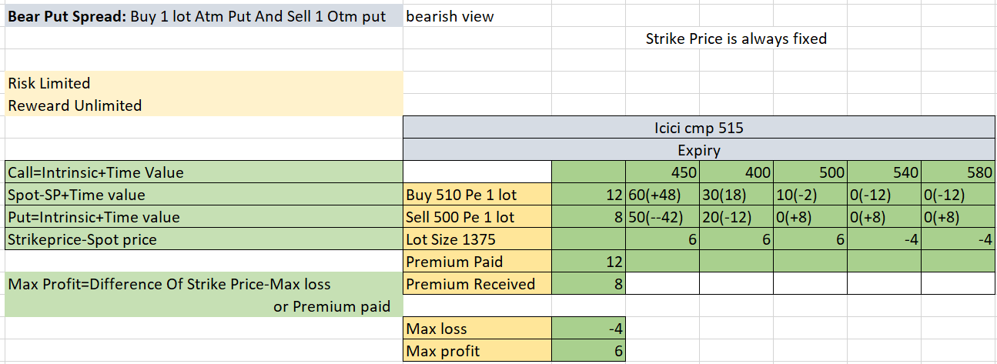

Slide 30
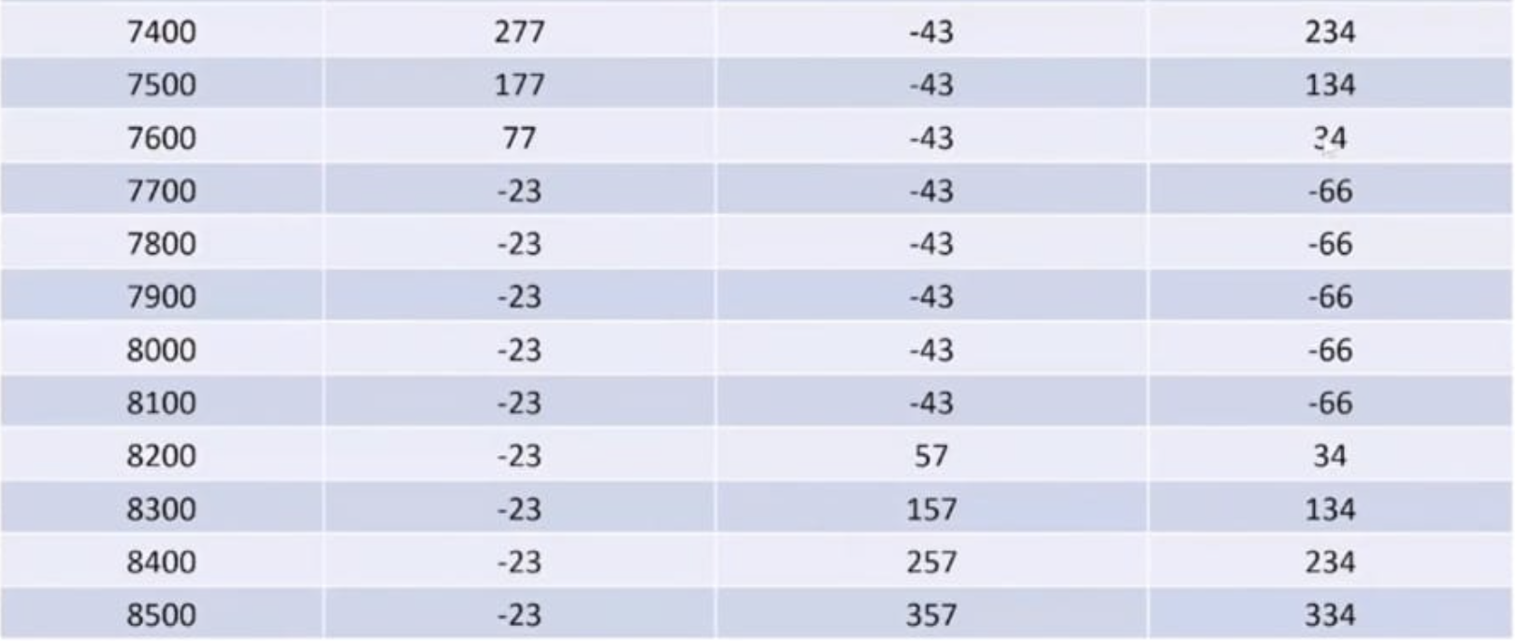
Long Strangle Payoff
Nifty @ Expiry | Put Payoff | Call Payoff | Net Payoff
7300 | 377 | -43 | 344

Slide 31
Thank You

